Slide 1
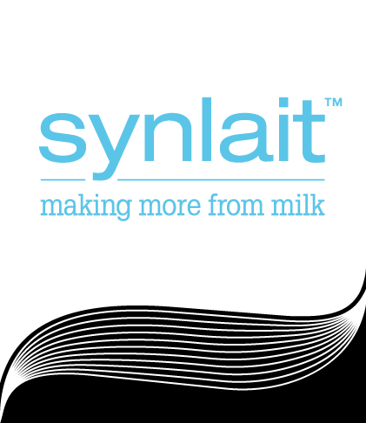
Fy16 earnings update
12 August 2016

Slide 2
disclaimer
This presentation contains projections or forward looking statements regarding a variety of items. Such projections or forward looking statements are based on current expectations, estimates and assumptions made by management of Synlait Milk Limited (SML) and are subject to a number of risks, uncertainties and assumptions. There is no assurance that results contemplated in any projections and forward looking statements in this presentation will be realised.
Further, past performance information given in this presentation is given for illustration purposes only and should not be relied upon as (and is not) an indication of future performance. The forward-looking statements involve known and unknown risks, uncertainties and other factors that may cause SML’s actual results, performance or achievements to differ materially from any future results, performance or achievements expressed or implied by these forward-looking statements. None of SML, their advisers and related companies and affiliates including, in each case, their respective shareholders, directors, officers, employees, gives any representation, assurance or guarantee that the occurrence of the events expressed or implied in any forward looking statements in this presentation will actually occur. Investors are cautioned not to place undue reliance on this information.
Any financial information included in this presentation may include non-GAAP financial measures and information. Not all of the financial information (including any non-GAAP information) will have been prepared in accordance with, nor is it intended to comply with: (i) the financial or other reporting requirements of any regulatory body, including the New Zealand Financial Markets Authority; or (ii) the accounting principles generally accepted in New Zealand or any other jurisdiction or with International Financial Reporting Standards.

Slide 3
introduction
This presentation, dated 12 August 2016, provides additional comment and should be read in conjunction with our NZX and media release of the same date.
This guidance is based upon a combination of forecasted and unaudited financial information.
We are providing guidance for the financial year ending 31 July 2016 (FY16) as our earnings are forecast to exceed current market expectations.
We will be releasing our final audited FY16 results on 19 September 2016.

Slide 4
Improving product mix
Capital projects funded by IPO in 2013 are now complete.
Since IPO, sales volumes have grown with milk supply and supported in FY16 by the commissioning of the third spray dryer.
Product mix has improved since IPO with strong growth in canned infant volumes (a consumer packaged product) subsequent to the commissioning of the consumer packaging facility in FY15.
Canned infant formula volumes have increased to 16,000 metric tonne (MT) from 4,300 MT last year.
Sales volumes by product category
Powders and cream products | Consumer packaged products
Speciality ingredients
NOTE: All FY16 results are forecast results.

Slide 5
Improving product mix
Product Mix: FY13 – FY16
Sales fy13
Sales fy16
Powders and cream products | Consumer packaged products
NOTE: All FY16 results are forecast results.

Slide 6
Underlying earnings ahead of expectation
Our value added strategy has enabled Synlait to make more from milk.
FY16 forecast underlying result of $32.0 million - $33.0 million (FY15: $12.2 million) and forecast reported NPAT of $34.0 million - $35.0 million (FY15: $10.6 million).
Underlying net profit / (loss) after taxation
Consumer packaged volumes (MT)
NOTE: All FY16 results are forecast results.

Slide 7
Underlying earnings ahead of expectation (cont’d)
Continued growth in underlying earnings driven by improved margins, with gross profit per MT increased to approximately $880 / MT from $593 / MT in FY15
We have increased our investment in customer development and operational excellence opportunities in FY16 and will continue into FY17.
These investments are expected to lead to future growth in infant formula volumes and improvements in key value drivers, such as reduced inventory and increased quality performance, in future periods.
Gross profit per Metric tonne
Gross Profit per MT includes the impact of reclassifying export freight costs that were previously classified in sales and distributions expenses. All comparatives have been adjusted accordingly.
NOTE: All FY16 results are forecast results.

Slide 8
Net debt lower than expected
Net debt peaked in FY15 as construction of the third spray dryer neared completion.
Operating cash flows for FY16 at approximately $100.0 million compare to $16.3 million in FY15.
As a result, net debt has reduced to approximately $214.0 million and leverage has improved to circa 2.5x.
Net debt / ebitda
Net debt / EBITDA (trailing)
NOTE: All FY16 results are forecast results.

Slide 9
For more information, please contact:
Dan Walraven
Communications Manager, Synlait Milk
P: +64 27 836 7532
E: Daniel.Walraven@synlait.com
W: www.synlait.com

